Slide 1
Detecting Endometriosis Within Laparoscopic Imaging
By Allie Wicklund

Slide 2
Table of Contents
What is Endometriosis?
GLENDA
How to Clean a Database
Google Colab
Images and their Annotations (now with version 2.0!)
Conclusions and Recommendations

Slide 3
What is Endometriosis?
A condition resulting from the appearance of endometrial tissue outside the uterus and causing pelvic pain

Slide 4
GLENDA
Gynecologic Laparoscopy ENdometriosis DAtaset
Alpen-Adria University in Austria
25,683 images of laparoscopic surgery (521 annotations)

Slide 5
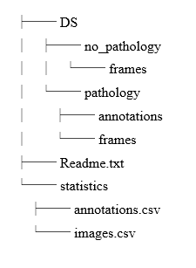
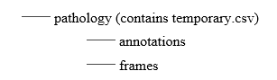
How to Clean a Database

Slide 6
Google Colab
Powerful cloud-based computing software
Can train models “quickly”
Has some technical difficulties during high usage

Slide 7
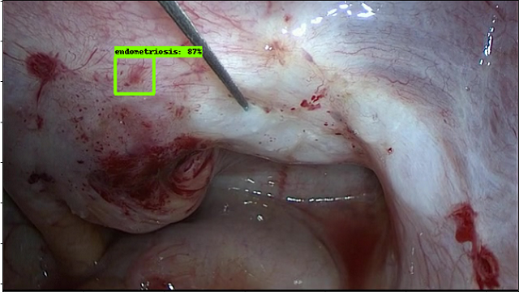

Slide 8
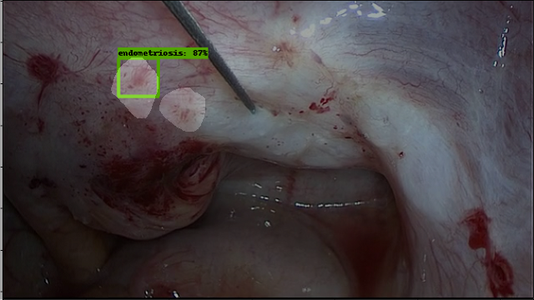

Slide 9
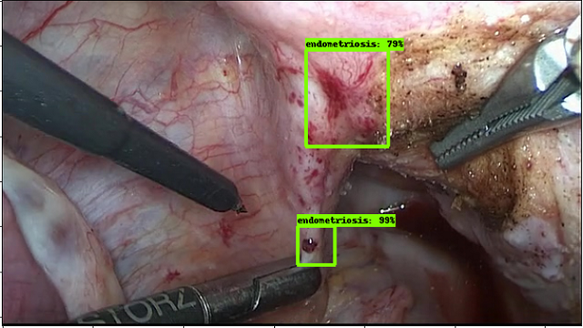

Slide 10
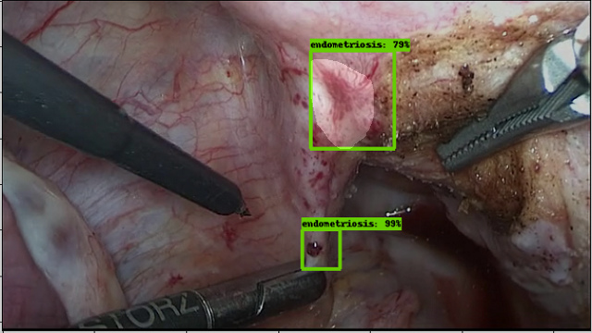

Slide 11
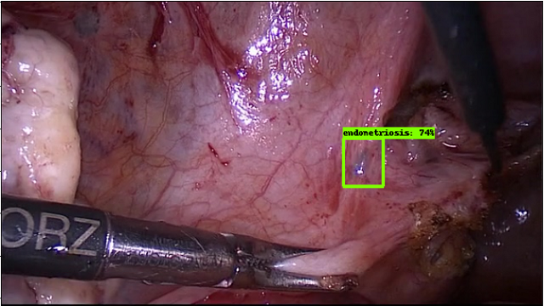

Slide 12
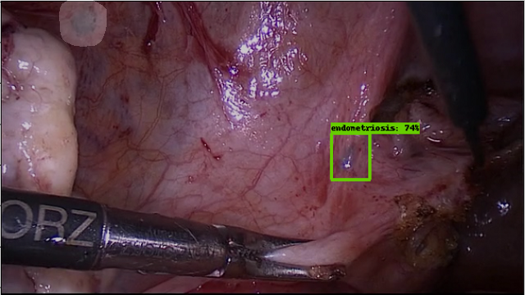

Slide 13
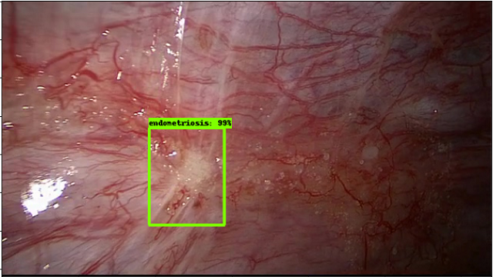

Slide 14
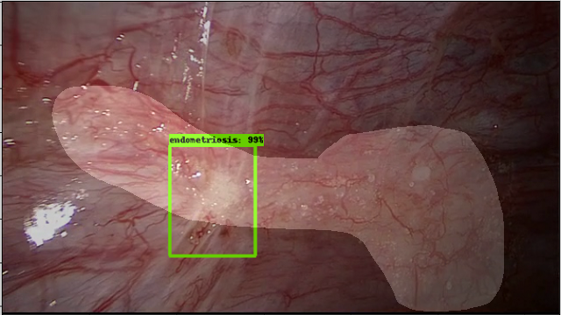

Slide 15
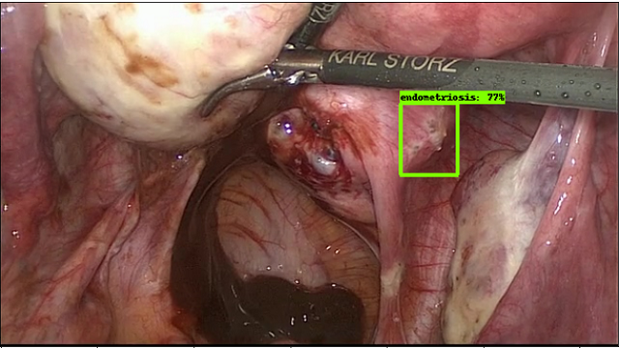

Slide 16
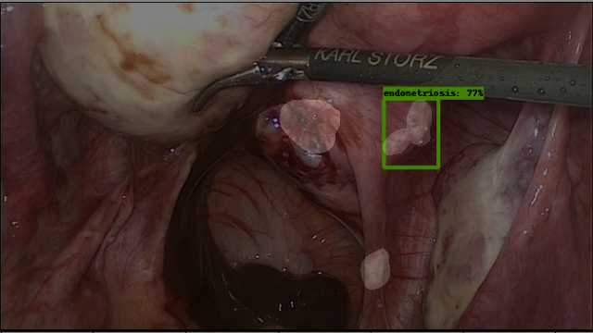

Slide 17
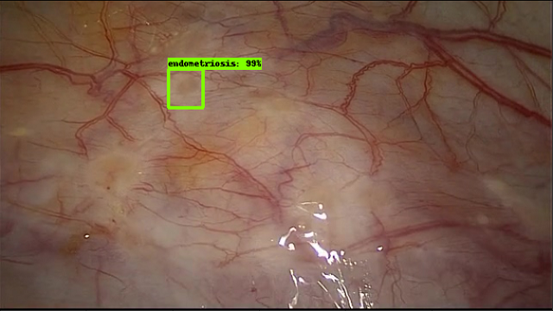

Slide 18
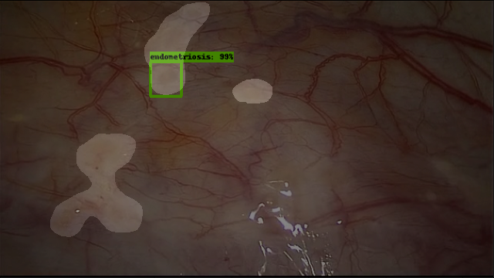

Slide 19
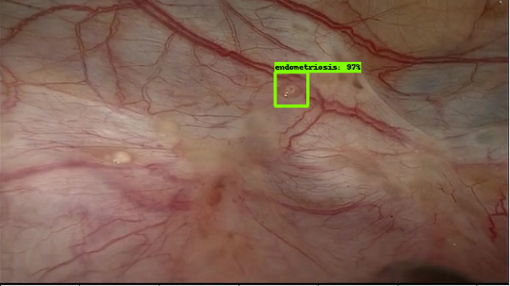

Slide 20
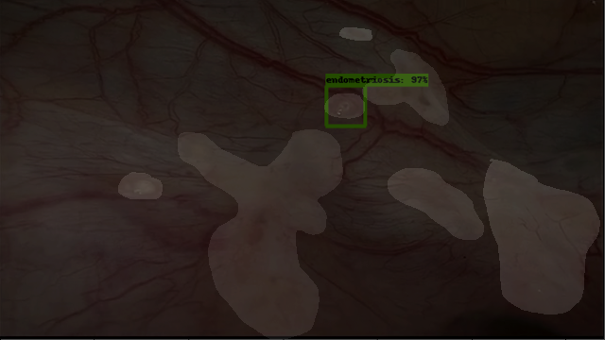

Slide 21
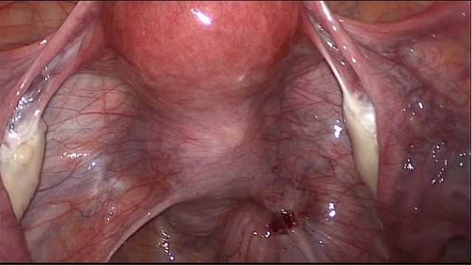

Slide 22
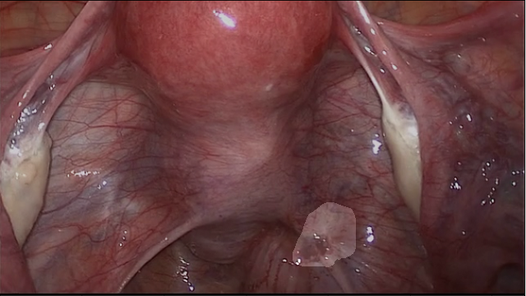

Slide 23
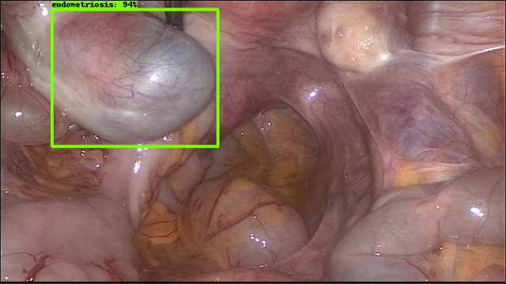

Slide 24
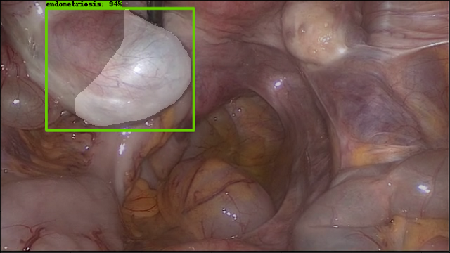

Slide 25
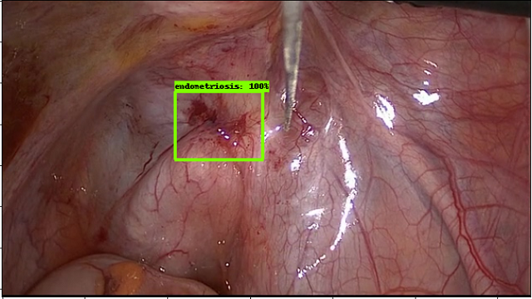

Slide 26
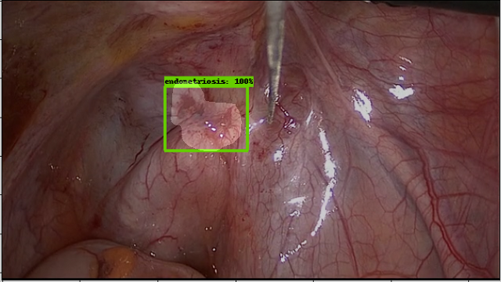

Slide 27
Version 1.0 Precision
TP/(TP+FP)
8/10 = 80%

Slide 28
Why Precision?
Requires TP and FP only
Less cuts are usually better
What would be a TN in this case?

Slide 29
Version 2.0
Uses dropout of 50%
Less likely to overfit data
Uses Data Augmentation
Flips, crops, color changes, rotation, etc.
Total steps: 1 million!
Reduces total loss
Compared to 30,000 steps

Slide 30
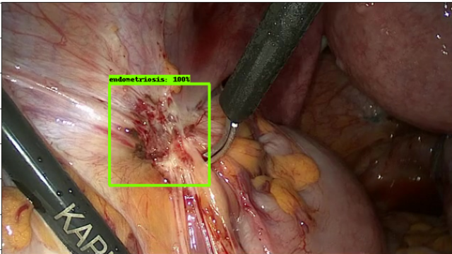

Slide 31
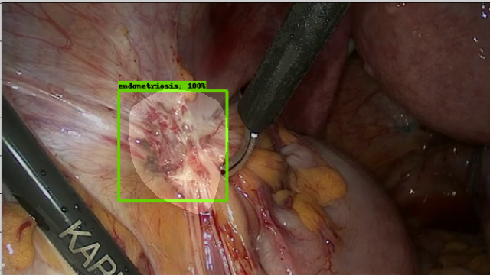

Slide 32
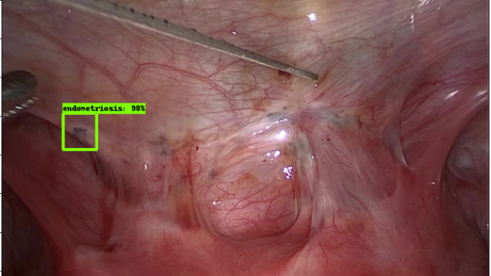

Slide 33
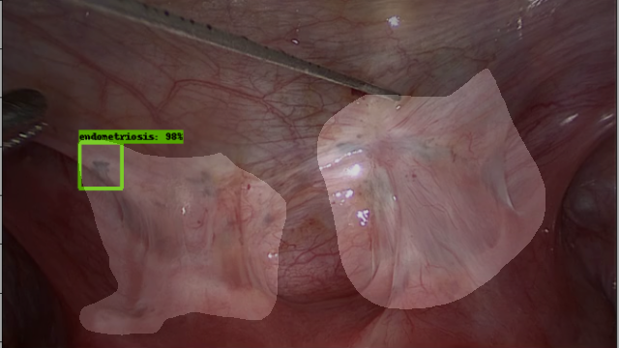

Slide 34
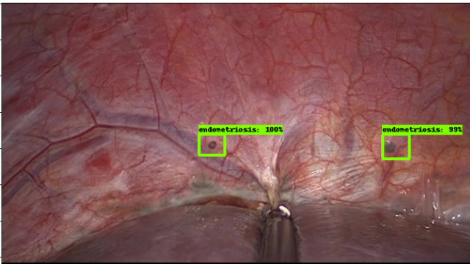

Slide 35
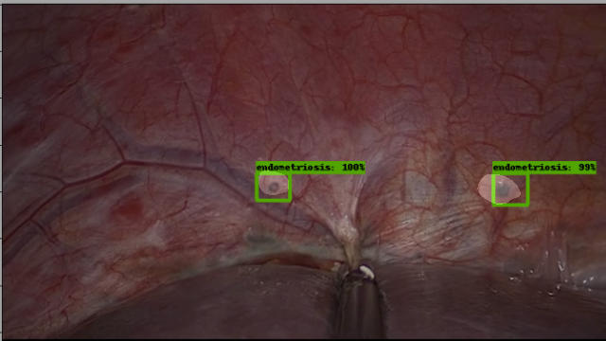

Slide 36
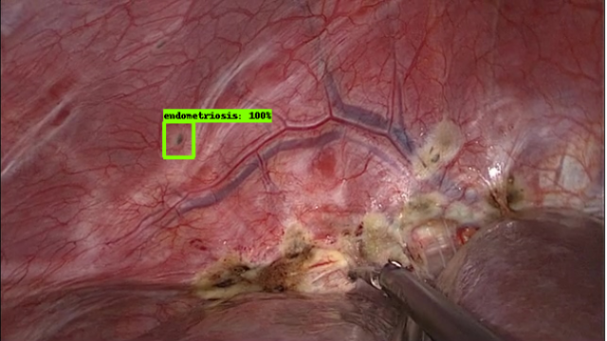

Slide 37
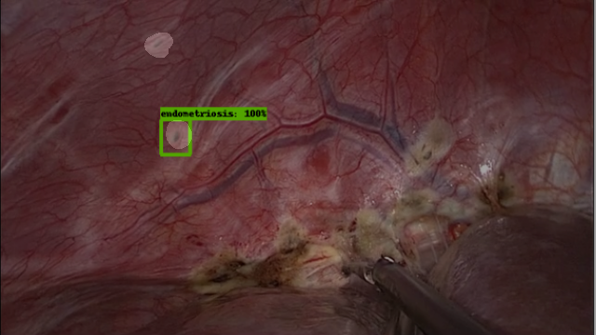

Slide 38
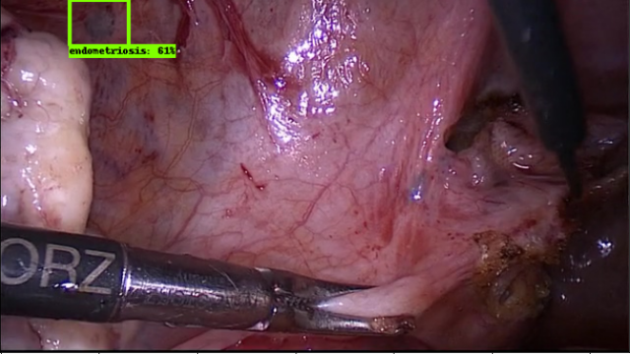

Slide 39
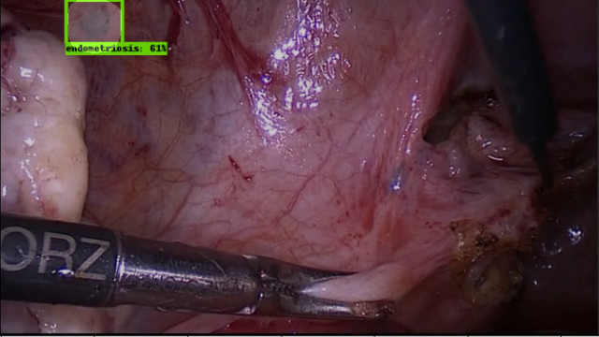

Slide 40
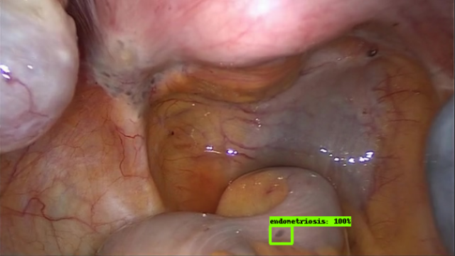

Slide 41
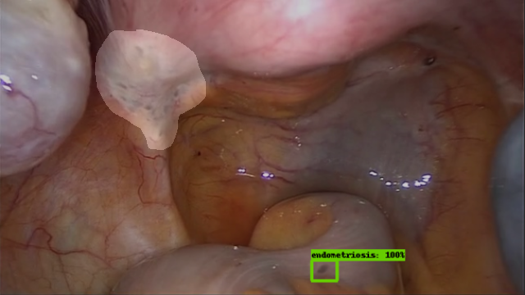

Slide 42
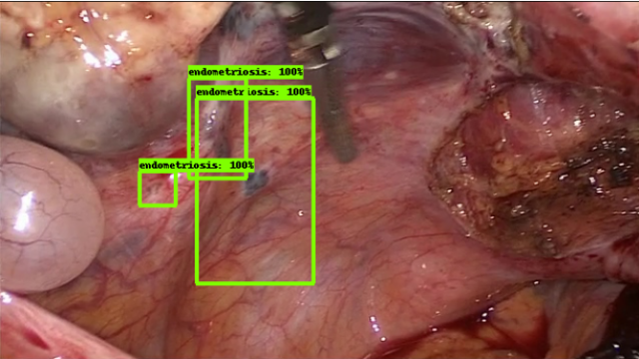

Slide 43
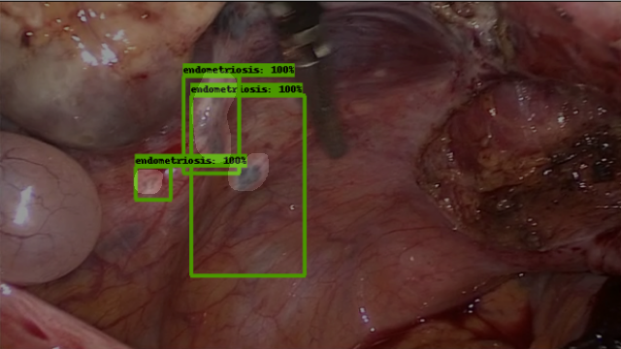

Slide 44
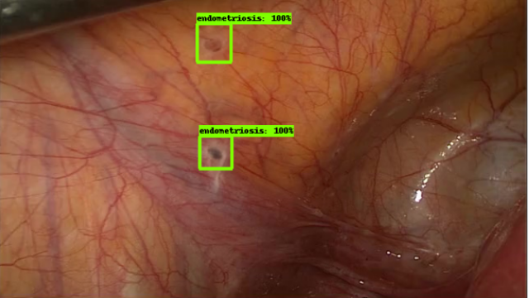

Slide 45
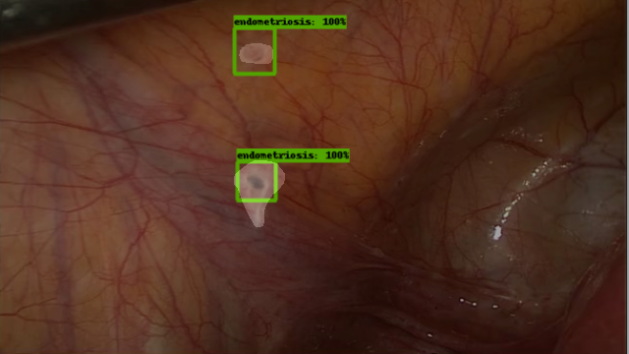

Slide 46
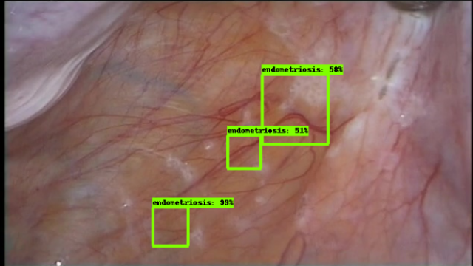

Slide 47
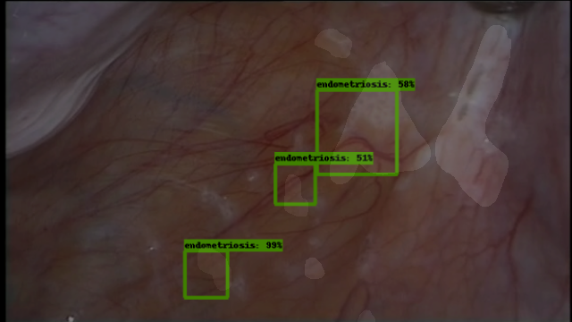

Slide 48
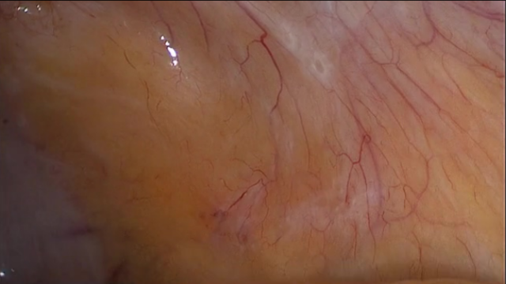

Slide 49
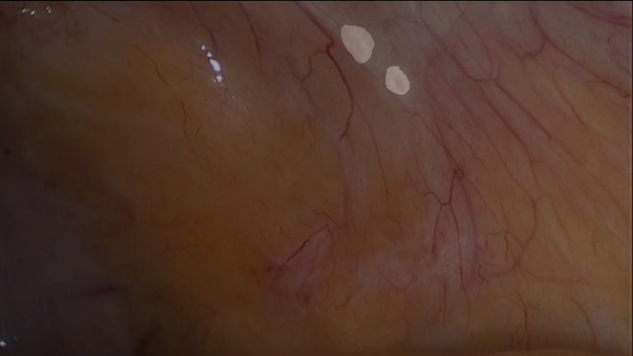

Slide 50
Version 2.0 Precision
TP/(TP+FP)
14/15 = .9333333 = 93%
Compared to 1.0 at 80%

Slide 51
Conclusions and Recommendations
More Images
Go with version 2.0 over 1.0 model
Update to video on a scope

